Slide 1
Trustworthy Online Controlled Experiments:
Five Puzzling Outcomes Explained
Ronny Kohavi with Alex Deng, Brian Frasca, Roger Longbotham, Toby Walker, Ya Xu
Slides available at http://exp-platform.com

Slide 2
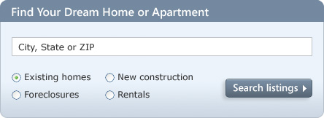
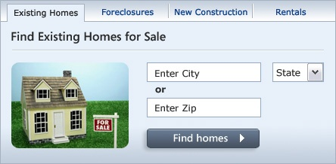
MSN Real Estate
“Find a house” widget variations
Overall Evaluation Criterion: Revenue to Microsoft generated every time a user clicks search/find button
A
B
Raise your right hand if you think A Wins
Raise your left hand if you think B Wins
Don’t raise your hand if you think they’re about the same

Slide 3
MSN Real Estate
A was 8.5% better (those who raised their right hand)
Since this is the #1 monetization for MSN Real Estate, it improved revenues significantly
Actual experiment had 6 variants
  There was a “throwdown” (vote for the winning variant) and nobody from MSN Real Estate or Zaaz (the company that did the creative) voted for the winning widget
This is very common: we are terrible at correctly assessing the value of our own ideas/designs
At Bing, it is not uncommon to see experiments that impact annual revenue by millions of dollars, sometimes tens of millions of dollars

Slide 4

Controlled Experiments in One Slide
Concept is trivial
  Randomly split traffic between
  two (or more) versions
    A/Control
    B/Treatment
  Collect metrics of interest
  Analyze
Unless you are testing on one
of largest sites in the world, use 50/50% (high stat power)
Must run statistical tests to confirm differences are not due to chance
Best scientific way to prove causality, i.e., the changes in metrics are caused by changes introduced in the treatment(s)

Slide 5
Puzzle 1: OEC for Search
An OEC is the Overall Evaluation Criterion
It is a metric (or set of metrics) that guides the org as to whether A is better than B in an A/B test
In prior work, we emphasized long-term focus and thinking about customer lifetime value, but operationalizing it is hard
Search engines (Bing, Google) are evaluated on query share (distinct queries) and revenue as long-term goals
Puzzle
  A ranking bug in an experiment resulted in very poor search results
  Distinct queries went up over 10%, and revenue went up over 30%
  What metrics should be in the OEC for a search engine?

Slide 6


Puzzle 1 Explained
Degraded (algorithmic) search results cause users to search more to complete their task, and ads appear more relevant
Analyzing queries per month, we have
$\frac{Queries}{Month} =\frac{Queries}{Session}× \frac{Sessions}{User}×\frac{Users}{Month}$
  where a session begins with a query and ends with 30-minutes of inactivity. (Ideally, we would look at tasks, not sessions).
Key observation: we want users to find answers and complete tasks quickly, so queries/session should be smaller
In a controlled experiment, the variants get (approximately) the same number of users by design, so the last term is about equal
The OEC should therefore include the middle term: sessions/user

Slide 7
Puzzle 2: Click Tracking
A piece of code was added, such that when a user clicked on a search result, additional JavaScript was executed
(a session-cookie was updated with the destination)
before navigating to the destination page
This slowed down the user experience slightly, so we expected a slightly negative experiment.
Results showed that users were clicking more!
Why?

Slide 8
Puzzle 2: Click Tracking - Background
User clicks (and form submits) are instrumented and form the basis for many metrics
Instrumentation is typically done by having the web browser request a web beacon (1x1 pixel image)
Classical tradeoff here
  Waiting for the beacon to return slows the action (typically navigating away)
  Making the call asynchronous is known to cause click-loss, as the browsers can kill the request (classical browser optimization because the result can’t possibly matter for the new page)
Small delays, on-mouse-down, or redirect are used

Slide 9
Puzzle 2: Click Tracking Explained
Click-loss varies dramatically by browser
Chrome, Firefox, Safari are aggressive at terminating such reqeuests. Safari’s click loss > 50%.
IE respects image requests for backward compatibility reasons
White paper available on this issue here
Other cases where this impacts experiments
  Opening link in new tab/window will overestimate the click delta
  Because the main window remains open, browsers can’t optimize and kill the beacon request, so there is less click-loss
  Using HTML5 to update components of the page instead of refreshing the whole page has the overestimation problem

Slide 10
Background: Primacy and Novelty Effects
Primacy effect occurs when you change the navigation on a web site
  Experienced users may be less efficient until they get used to the new navigation
  Control has a short-term advantage
Novelty effect happens when a new design is introduced
  Users investigate the new feature, click everywhere, and introduce a “novelty” bias that dies quickly if the feature is not truly useful
  Treatments have a short-term advantage

Slide 11
Puzzle 3: Effects Trend
Given the high failure rate of ideas, new experiments are followed closely to determine if new idea is a winner
Multiple graphs of effect look like this
  Negative on day 1: -0.55%
  Less negative on day 2: -0.38%
  Less negative on day 3: -0.21%
  Less negative on day 4: -0.13%
The experimenter extrapolates linearly
and says: primacy effect.
This will be positive in a couple of days, right?
Wrong! This is expected

Slide 12

Puzzle 3: Effects Trend
For many metrics, the standard deviation of the mean is proportional to $1⁄√n$, where $n$ is the number of users
As we run an experiment longer, more users are admitted into the experiment, so $n$grows and the conf interval shrinks
The first days are highly variable
The first day has a 67% chance
of falling outside the 95% CI
at the end of the experiment
The second day has a 55% chance
of falling outside this bound.

Slide 13
Puzzle 3: Effects Trend
The longer graph
This was an A/A test, so the true effect is 0

Slide 14
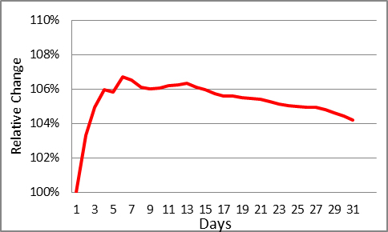
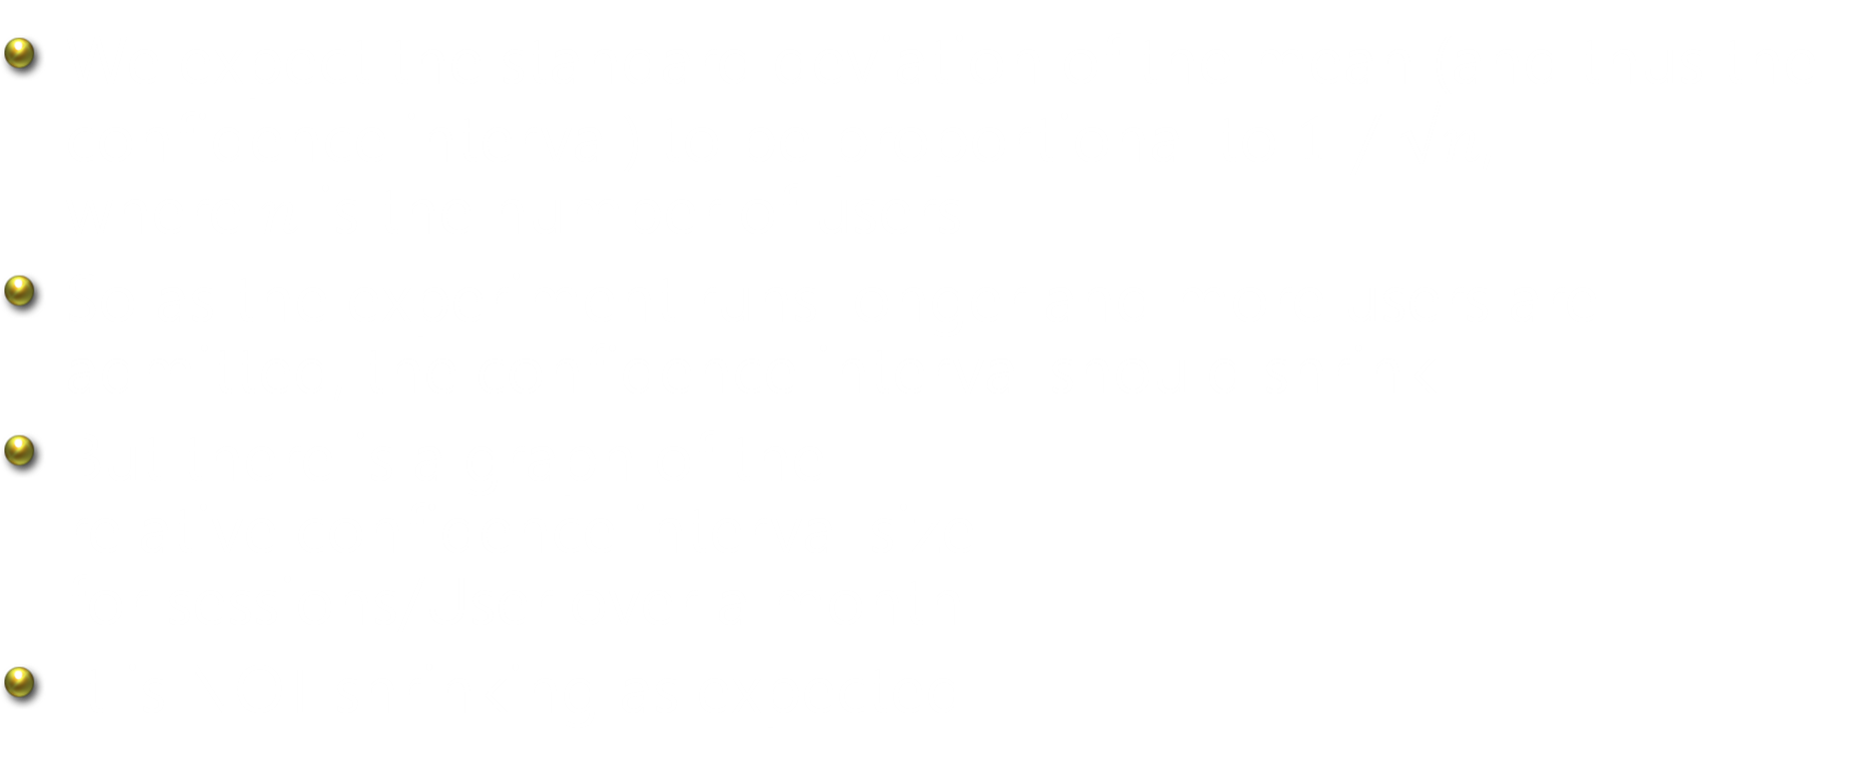
Puzzle 4: Statistical Power
We expect the standard deviation of the mean (and thus the confidence interval) to be proportional to $1⁄√n$,
where $n$ is the number of users
So as the experiment runs longer and more users are admitted, the confidence interval should shrink
But there is a graph of the
relative confidence interval size
for sessions/User over a month
It is NOT shrinking as expected

Slide 15
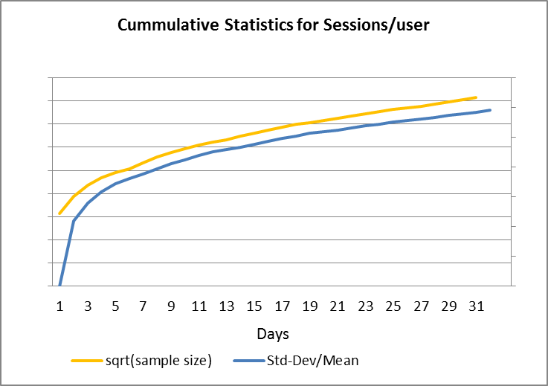
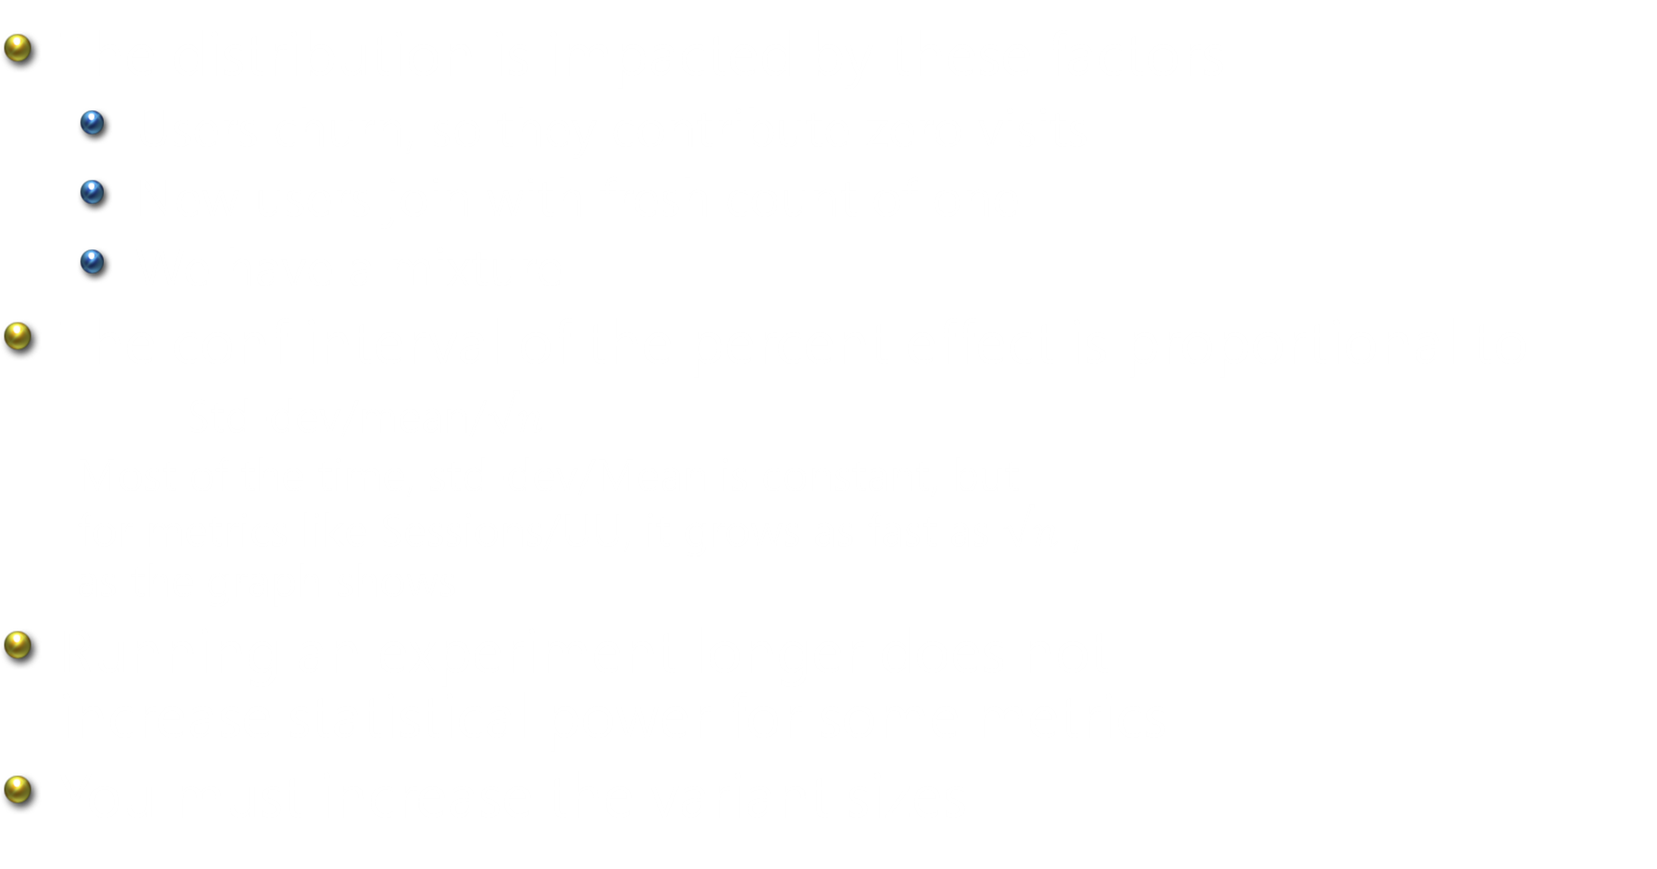
Puzzle 4: Statistical Power
The distribution is impacted by these factors
  Users churn, so they contribute zero visits
  New users join with fresh count of one
  We have a mixture
The conf interval of the percent effect is proportional to
      Std-dev/mean/$√n$
  Most of the time, std-dev/Mean is constant, but
  for metrics like Sessions/UU, it grows as fast as $√n$ ,
  as the graph shows
Running an experiment longer does not
increase statistical power for some metrics
You must increase the variant sizes

Slide 16
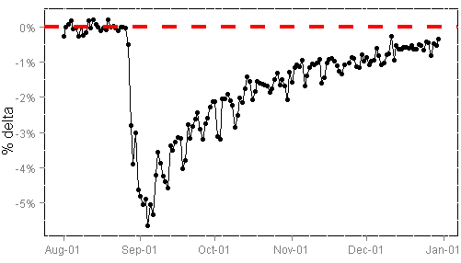
Puzzle 5: Carryover Effects
Experiment is run, results are surprising.
(This by itself is fine, as our intuition is poor.)
Rerun the experiment, and the effects disappear
Reason: bucket system recycles users, and the prior experiment had carryover effects
These can last for months!
Must run A/A tests, or re-randomize

Slide 17
Summary
OEC: evaluate long-term goals through short-term metrics
The difference between theory and practice is greater in practice than in theory
  Instrumentation issues (e.g., click-tracking) must be understood
  Carryover effects impact “bucket systems” used by Bing, Google, and Yahoo require rehashing and A/A tests
Experimentation insight:
  Effect trends are expected
  Longer experiments do not increase power for some metrics.
  Fortunately, we have a lot of users

